Slide 1
KCGL ERP - CSP Drive
How to take CSP (Customer Service Package) follow-ups in the ERP
Covers three situations:
1. Customer available on the Drive Data page,
2. Customer is not in any drive (Non-Drive)
3. CSP reports and manual CSP SR entry from the Dashboard.
Every step has a screenshot with red markers ①, ②, ③ showing exactly where to click

Slide 2
CSP Guidelines and Terminologies
CSP | Customer Support Programme campaign / drive (e.g., CSP-E2FG-2026, CSP-F1F)
SR | Service Request
CSP Info box | Section on the customer page showing CSP details – GOEM/OEM, SR Number, SR Open/Close Date, SR Subtype, SR Status, Segment and Due Date
Subtype | CSP check type (e.g., A / B / C / D Check) saved along with the follow-up
Drive Data page | List of customers enrolled in drives
Non-Drive Data page | List of customers not enrolled in any drive
Module | Customer Engagement – CSP Drive Follow-ups
Purpose | Step-by-step process to take CSP follow-ups for Drive and Non-Drive customers, and to manage CSP records from the Dashboard
Intended Users | Tele-callers / Service co-ordinators / Branch managers

Slide 3
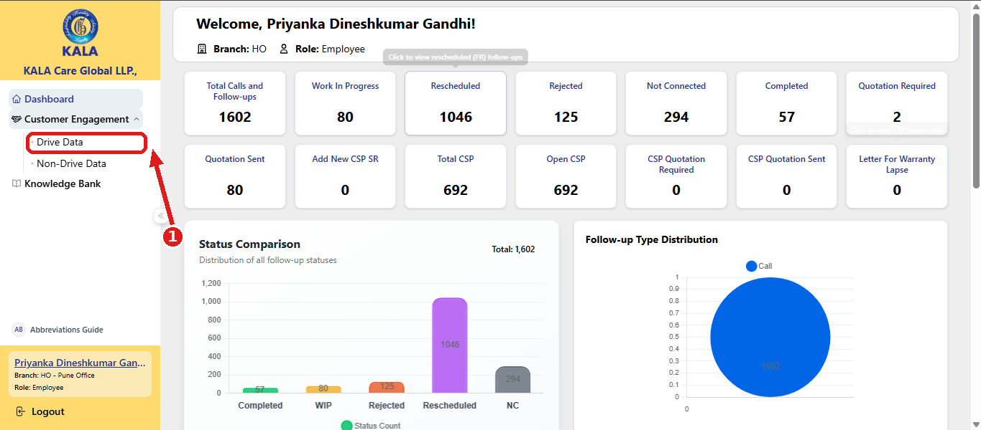
CSP Follow Up Steps - Section 1: Follow-up on CSP from the Drive Data Page
Step 1: Log in to the portal. Open the Drive Data page. In the left menu, expand Customer Engagement and click Drive Data ①

Slide 4
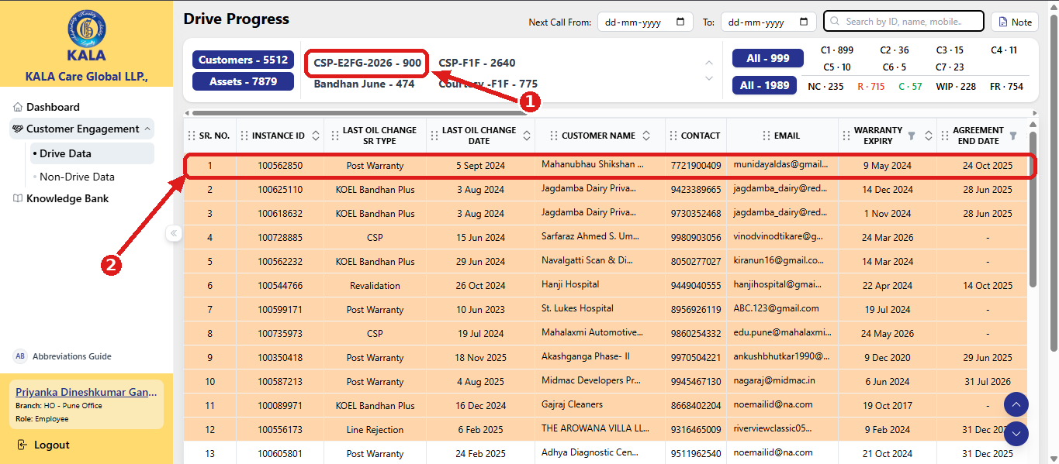
CSP Follow Up Steps - Section 1: Follow-up on CSP from the Drive Data Page
Step 2: Select the CSP drive and the customer. On the Drive Progress page, click the CSP drive name in the summary bar – for example CSP-E2FG-2026 ①. The customer list of that drive is displayed. Click the customer for whom the follow-up is to be taken ②

Slide 5
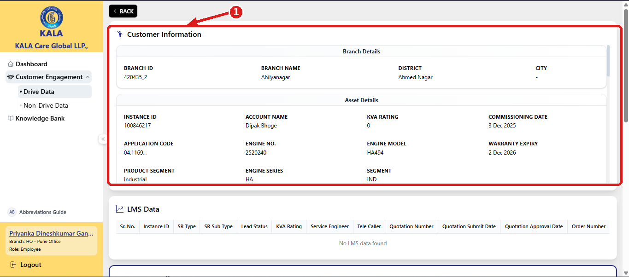
CSP Follow Up Steps - Section 1: Follow-up on CSP from the Drive Data Page
Step 3: The Customer Information page opens and shows the complete details of the customer – branch details, asset details and the registered contact / mobile number ①

Slide 6
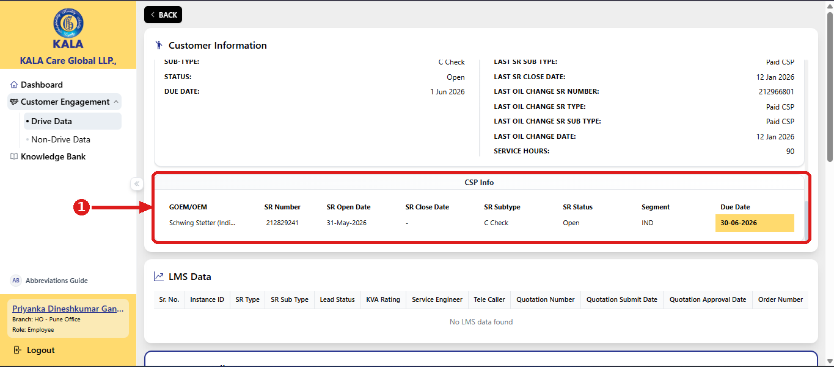
CSP Follow Up Steps - Section 1: Follow-up on CSP from the Drive Data Page
Step 4: Check the CSP Info box. Scroll down to the CSP Info box ①. It shows all CSP related details of the customer: GOEM/OEM, SR Number, SR Open Date, SR Subtype, SR Status, Segment and Due Date

Slide 7
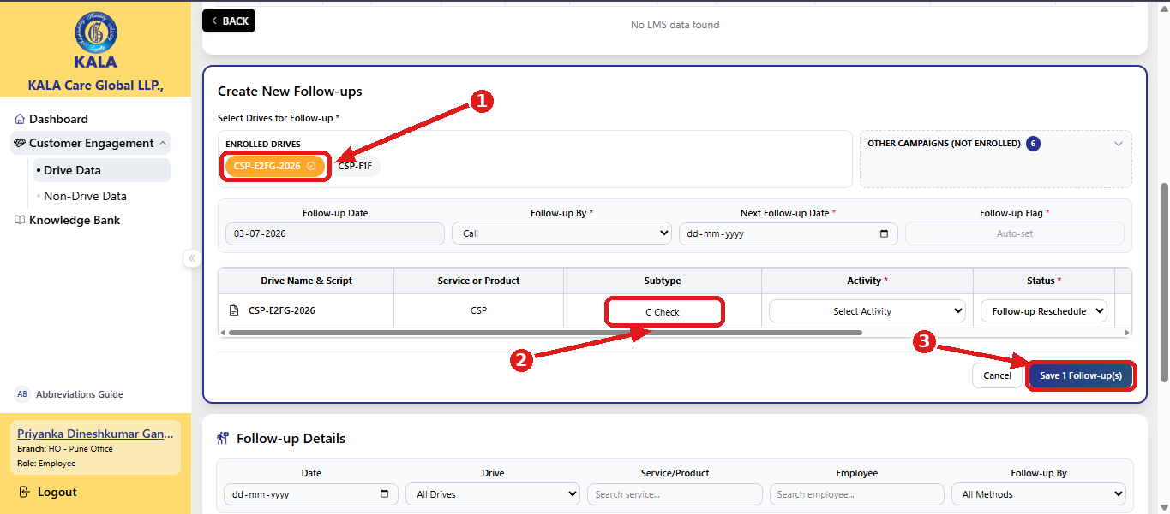
CSP Follow Up Steps - Section 1: Follow-up on CSP from the Drive Data Page
Step 5: Take follow-up. In Create New Follow-ups, select the CSP drive under Enrolled Drives ① and take the follow-up exactly like any other drive. The Subtype (e.g., C Check) is saved automatically along with the follow-up ②. Fill the remaining details (Follow-up By, Next Follow-up Date, Activity, Status) and click Save ③

Slide 8
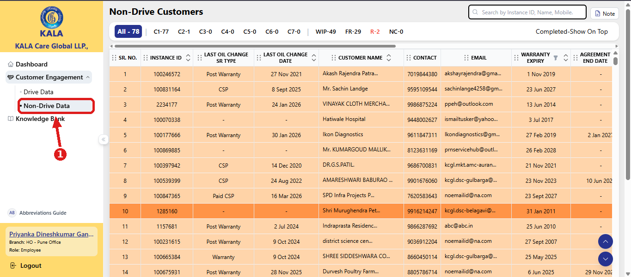
CSP Follow Up Steps Section 2 – CSP Follow-up for Non-Drive Customers
Step 1: Use this process when the customer is not available on the Drive Data page. Open the Non-Drive Data page
In the left menu, click Non-Drive Data ①

Slide 9
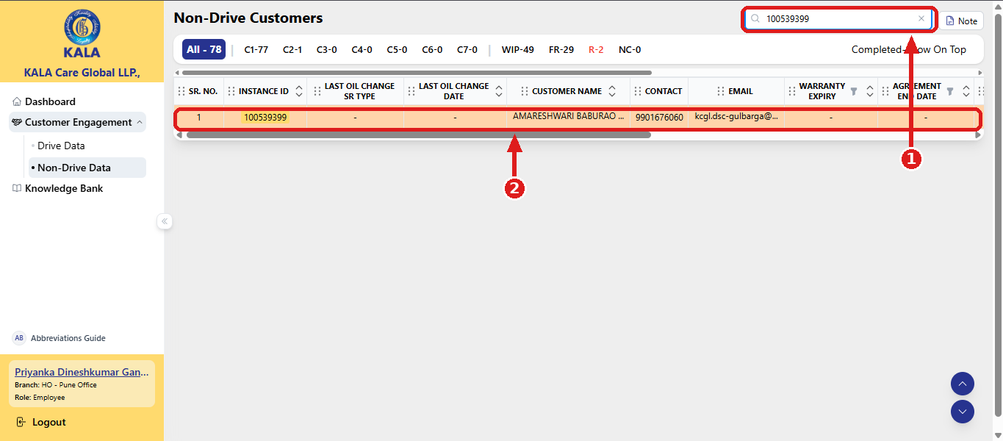
CSP Follow Up Steps Section 2 – CSP Follow-up for Non-Drive Customers
Step 2: Search the customer. In the Search box at the top-right, search the customer by Instance ID or Name ①. The matching record appears in the list – click it ②

Slide 10
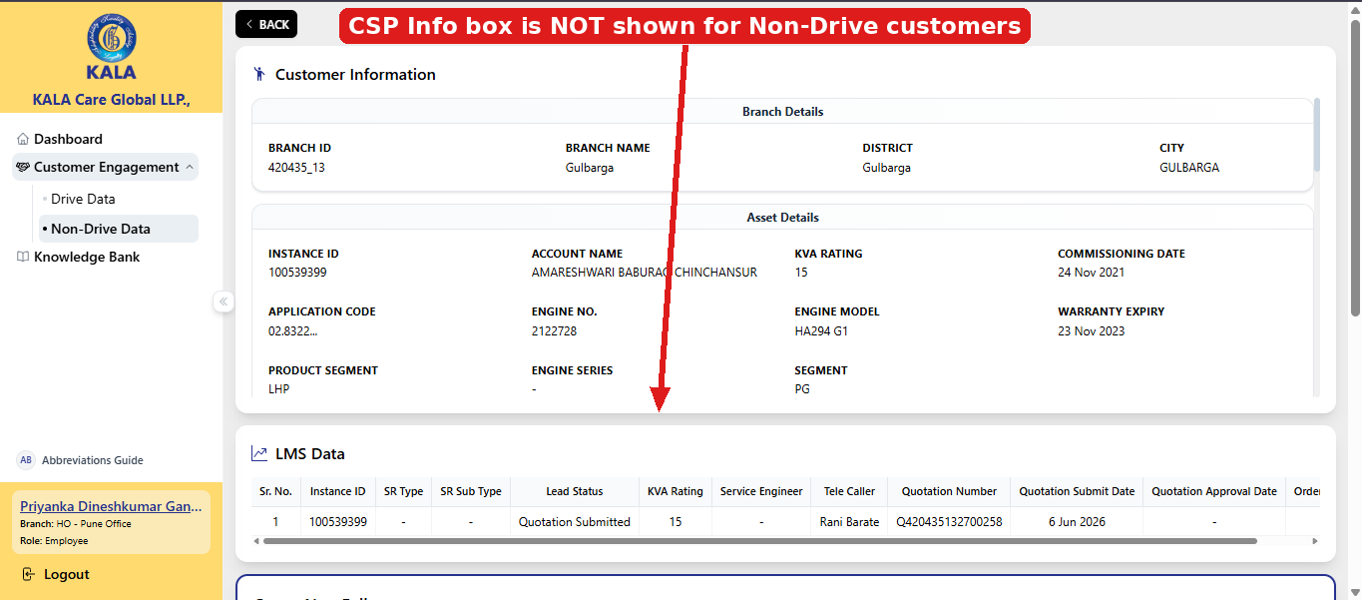
CSP Follow Up Steps Section 2 – CSP Follow-up for Non-Drive Customers
Step 3: Open the customer (CSP Info box is not shown). The Customer Information page opens.
Note that for Non-Drive customers the CSP Info box is NOT displayed.

Slide 11
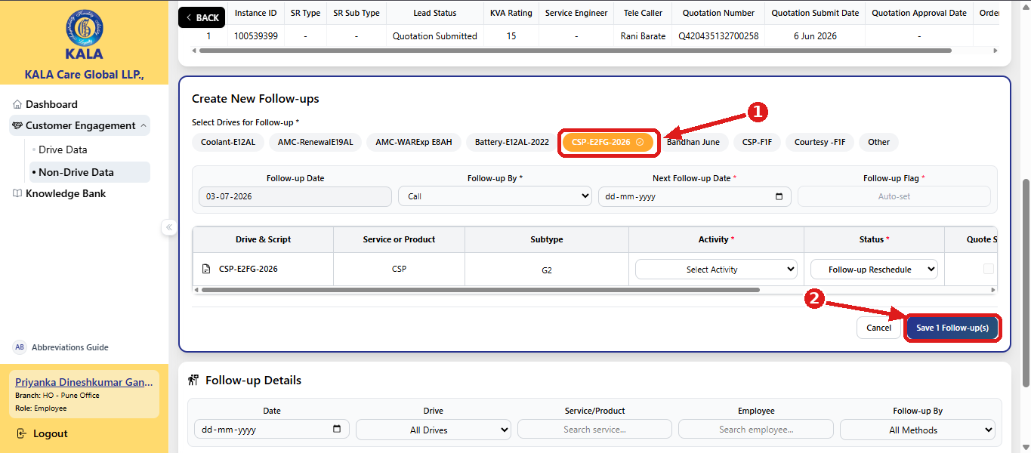
CSP Follow Up Steps Section 2 – CSP Follow-up for Non-Drive Customers
Step 4: Take follow-up in the same way as on the Drive Data page – select the CSP drive in Create New Follow-ups ①, fill the details and click Save ②

Slide 12
CSP Follow Up Steps Section 3 – Dashboard:
CSP Reports & Manual CSP SR Entry
** IMPORTANT **
New CSP customers are not part of Drive or Non-Drive date
Take new CSP details from Pulse and add them manually through Dashboard → Add New CSP SR (see Section 3, Step 11)
After this step, the details will appear in the CSP Info box during follow-up.

Slide 13
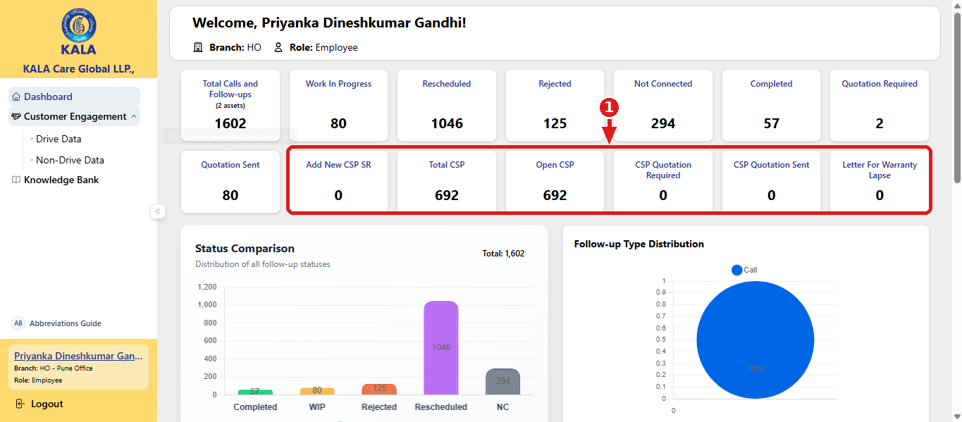
CSP Follow Up Steps Section 3 – Dashboard:
CSP Reports & Manual CSP SR Entry
Step 1: CSP reports are on the Dashboard. Open the Dashboard. All CSP-related reports are shown in separate boxes ①. Add New CSP SR, Total CSP, Open CSP, CSP Quotation Required, CSP Quotation Sent and Letter for Warranty Lapse.

Slide 14
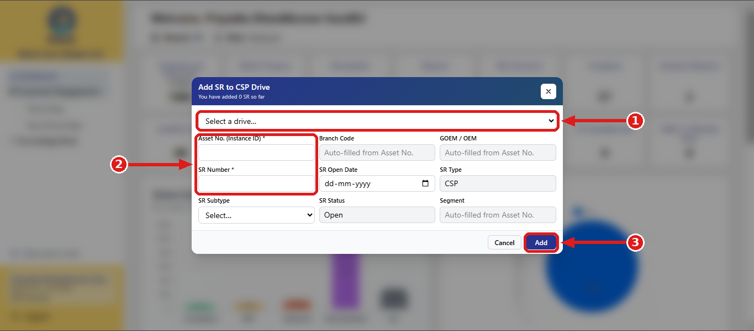
CSP Follow Up Steps Section 3 – Dashboard:
CSP Reports & Manual CSP SR Entry
Step 2: Add New CSP SR manually. Click the Add New CSP SR box to add a customer manually to the CSP drive, so that the details appear in the CSP Info box during follow-up. In the Add SR to CSP Drive window: select the CSP campaign / drive ①; fill all mandatory fields marked with * - Asset No. (Instance ID), SR Number, etc. ②; and click Add ③.
WARNING – Do not enter wrong information Verify every value from Pulse before clicking Add. Wrong entries will show incorrect CSP details to all users during follow-ups in the KCGL ERP.

Slide 15
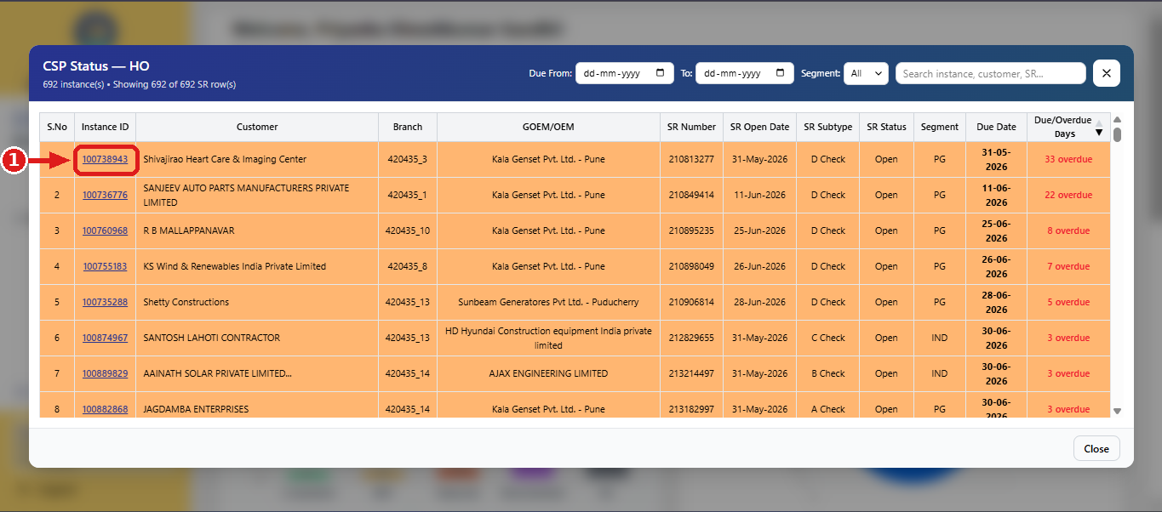
CSP Follow Up Steps Section 3 – Dashboard:
CSP Reports & Manual CSP SR Entry
Step 3: Work from the Open CSP report. Click the Open CSP box on the Dashboard to see all open CSP records. Click any record / Instance ID ① – the customer opens directly and the follow-up can be taken immediately.

Slide 16
Upcoming Feature
Letter Send functionality: Letter for Warranty Lapse is under development and will be available soon. This guide will be updated once the feature is released.
Quick Reference
Situation | What to do
Customer is in a CSP drive | Drive Data → Click CSP drive → Click customer → Check CSP Info box → Take follow-up (subtype saves automatically)
Customer is NOT in any drive | Non-Drive Data → search by Instance ID / Name → click customer → take follow-up (CSP Info box is not shown)
CSP details missing for a Non-Drive customer | Check Kirloskar ERP → Dashboard → Add New CSP SR → select campaign → fill * fields → Add
See / work on all open CSP records | Dashboard → Open CSP box → click a record → take follow-up directly
Do's and Don'ts
Do | Don't
Verify CSP details from Pulse before manual entry | Do not enter wrong or guessed information in Add New CSP SR
Fill all mandatory (*) fields while adding a CSP SR | Do not skip checking the CSP Info box before the call
Select the correct CSP campaign / drive for follow-up | Do not take a CSP follow-up without selecting the CSP drive

Slide 17


